Slide 1

Getting Started with Semantic Web Applications
Brian Panulla
Leif Warner
Open Source Bridge
2011
Notes:
http://www.flickr.com/photos/mayhem/3104825022/in/photostream/

Slide 2
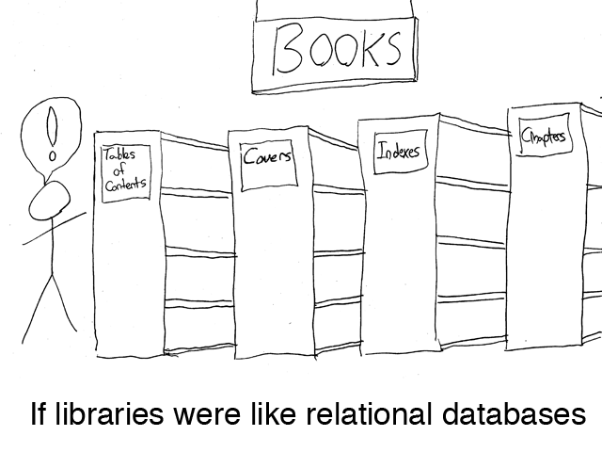

Slide 3
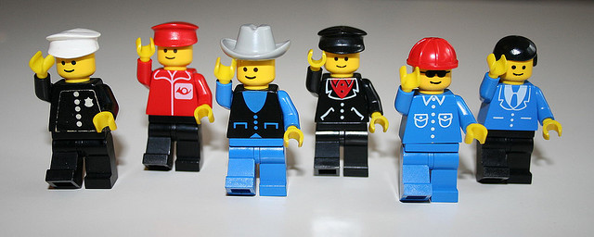
NoSQL: Key/Value and Graphs
Notes:
http://www.flickr.com/photos/herr_hartmann/448478567/in/photostream/
http://www.flickr.com/photos/mayhem/3104825022/in/photostream/

Slide 4
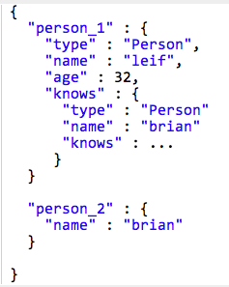
JSON
Strings, numbers, booleans
Arrays and objects

Slide 5
What’s missing?
Richer sharable semantics
Rules - declarative business logic
Like Triggers and Stored Procedures

Slide 6
Technology Primer

Slide 7
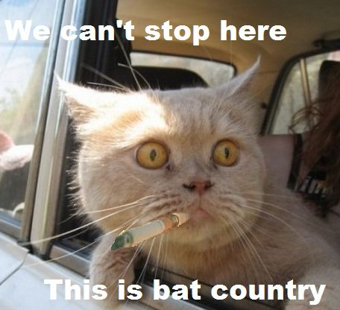
RDF: Framework for knowledge representation
Declares resources
Specifies properties of resources
W3C standard since 1999
http://www.w3.org/RDF/

Slide 8

RDF is not XML
...but occasionally dresses up like it
XML
N-Triples
N3
Turtle
JSON
RDFa
in HTML
...

Slide 9
URIs
Resources are identified by a Uniform Resource Identifier (URI)
URIs are the Primary Key values of the Semantic Web

Slide 10
URIs
... Are not necessarily URLs
urn:isbn:951-611-441-5
http://brian.panul.la
http://google.com/portland/conferences/osb11

Slide 11
URIs
.. Can point to conceptual entities...
<span about=“...”>
<li typeof=“...”>
... Instead of material entities
<a href=“...”>
<link href=“...”>
<img src=“...”>
<base href=“...”>

Slide 12
URIs
2 resources with different URIs are assumed to be distinct by default.
Id's and id references don't all have to be together in your local custom database, they can span the web.
loose coupling allows many sites to share data and collaborate

Slide 13
Triples
RDF is expressed as triples of URIs:
subject (“Portland State”) - resource
predicate (”is a") - property
object (”University”) - resource
Is a
Portland
State
University

Slide 14
Triples in RDF
subject
<http://www.pdx.edu>
<http://www.w3.org/1999/02/22-rdf-syntax-nsrdf#type>
<http://dbpedia.org/resource/University> .
predicate
object

Slide 15
Another example
subject (“Brian Panulla”)
predicate (”knows")
object (”Leif Warner”)
knows
Brian
Panulla
Leif
Warner

Slide 16
Triples
As RDF:
<http://github.com/bpanulla>
foaf:knows
<http://github.com/LeifW> .
“CURIE” *
* shorthand for <http://xmlns.com/foaf/0.1/knows>

Slide 17
Triples to Graphs
NATO
State of
California
Member of
Member of
Is in
borders
United
States of
America
Is in
State of
Oregon
Is in
City of
Portland
Canada
Is in
borders
Held In
Is located in
Is in
Is in
State of
Washington
Portland
State
_{OSB11}
North
America
presented At
Is a
Brian
Panulla
attended
Is a
Penn
State
University

Slide 18
Triple Stores
Graph database built around RDF
Quad Stores: triple store that includes provenance
“where did the data come from?”
Options!
Transactional / non-Transactional
In-Memory / File system / RDBMS storage

Slide 19
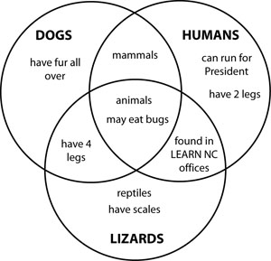
RDF Schemas
RDFS provides limited Set Theory features
subClassOf
subPropertyOf
Domain
Range
Think of classes in RDFS as sets rather than OOP classes

Slide 20

Defining an ontology
Web Ontology Language (OWL)
Version 2.0
(October 2009)
http://www.w3.org/TR/owl2-overview/
Yes, rly.
Notes:
http://www.flickr.com/photos/jingleslenobel/4971486823

Slide 21
Some RDFS/OWL Features
Classes
Sub-class
Equivalent Classes
Disjoint Classes
Cardinality constraints (max/min)
Individuals
Same Individual
Properties
Sub-property
Equivalent
Inverse
Symmetric
Transitive

Slide 22
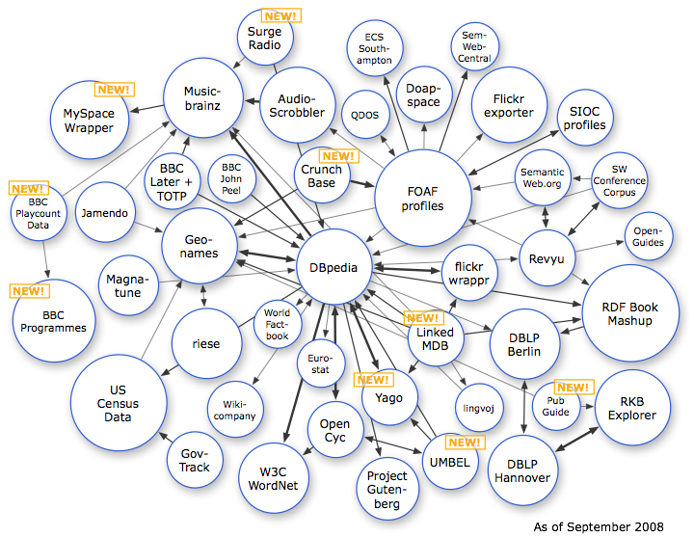
http://richard.cyganiak.de/2007/10/lod/

Slide 23
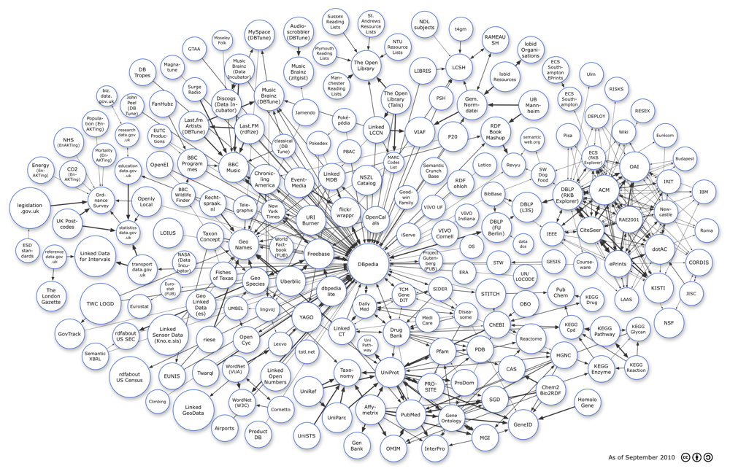
http://richard.cyganiak.de/2007/10/lod/

Slide 24
Case Study: Social Bookmarking

Slide 25
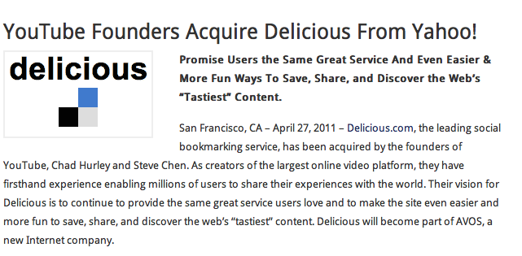

Del.icio.us

Slide 26
Basic Requirements
Information
People
Bookmarks
Tags
Functionality
Create an account
Add a bookmark
Delete a bookmark
Browse other users’ bookmarks

Slide 27
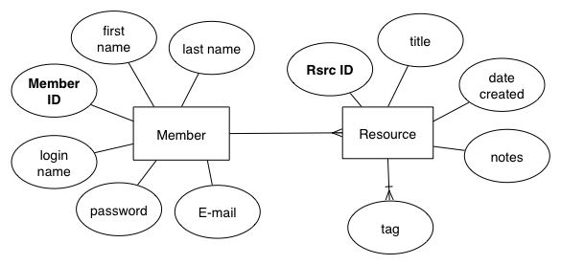
Logical Schema

Slide 28
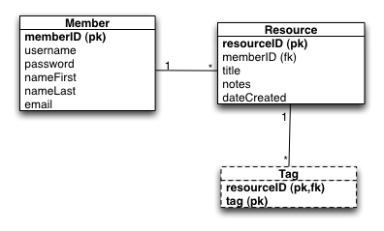
Relational DB - Physical Schema

Slide 29
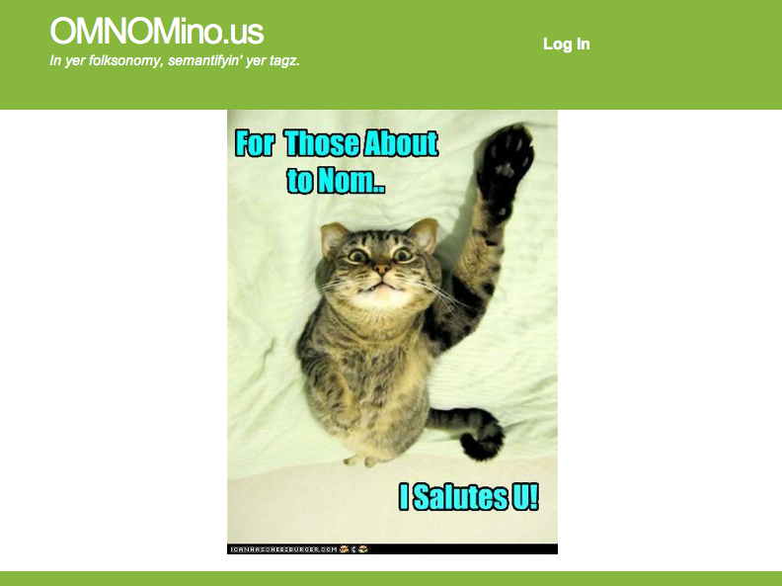
OMNOMino.us

Slide 30
Modeling in RDF
Re-use existing schemas or ontologies where appropriate

Slide 31



Useful Schemas
Dublin CORE METADATA INITIATIVE (DCMI)
Friend-of-a-friend
(FOAF)

Slide 32
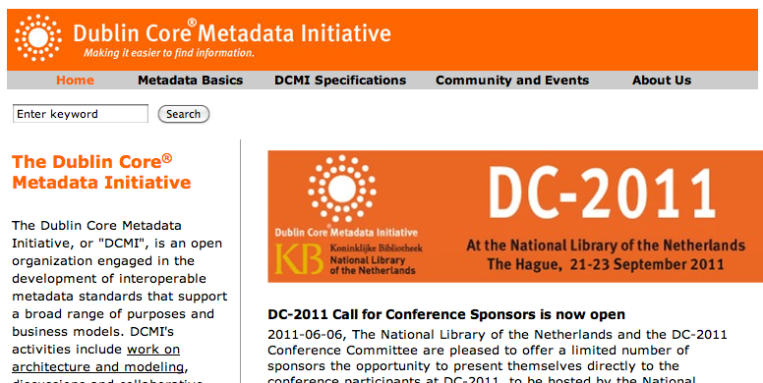
DMCI

Slide 33
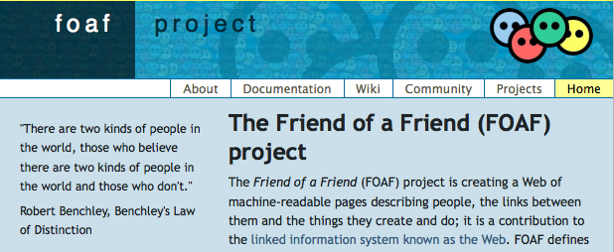
Well-defined ontology for people, organizations, and social networks

Slide 34
RDF Data Model - Member
foaf:Person
foaf:fullname
foaf:nickname
foaf:mbox
foaf:openid
Literal (“datataype”)properties
Resource (“object”)
property

Slide 35
RDF Data Model - Bookmark
foaf:Document
dct:title
dct:description
dct:created
dct:modified
foaf:page
foaf:topic
Literal (“datataype”)properties
Resource (“object”)
properties

Slide 36
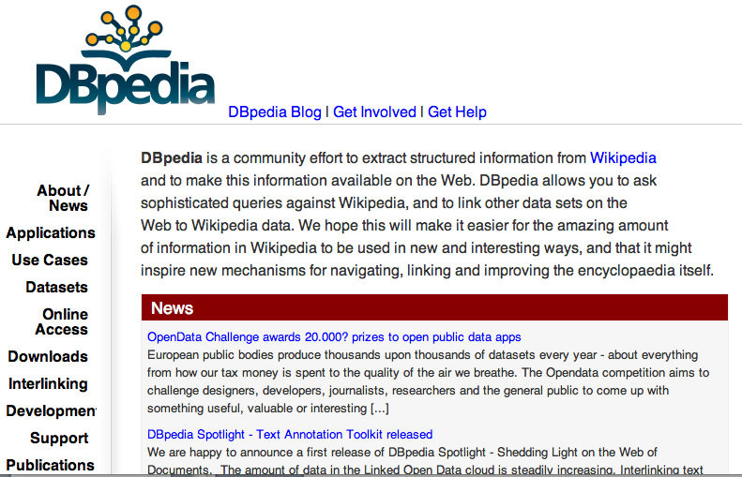
Topics from DBPedia
Semantified Wikipedia

Slide 37
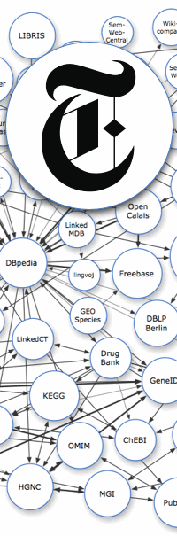


http://data.nytimes.com
http://id.loc.gov
http://www.freebase.com

Slide 38
Custom properties and classes
omnom:bookmarked
http://omnomino.us/ontology/om.n3#bookmarked
omnom:
bookmarked
foaf:
Person
foaf:
Document

Slide 39
Custom properties and classes
foaf:
Person
foaf:
Document
rdfs:
subClassOf
omnom:
Member
omnom:
Resource

Slide 40
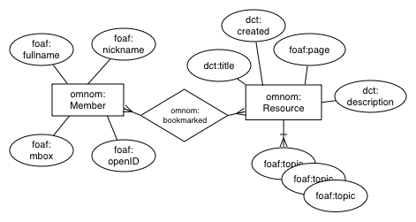
RDF Data Model

Slide 41
SPARQL
Graph query language
Read-only (1.0)
Safe to expose endpoint to Web
SPARQL 1.1 adds updates

Slide 42
A Simple SPARQL Example
SELECT ?subj ?pred ?obj
WHERE {
?subj ?pred ?obj.
}
Demo

Slide 43
SPARQL Examples: Member
SELECT DISTINCT ?uri ?fullname ?nickname ?email
WHERE {
?uri a omnom:Member.
OPTIONAL {
?uri foaf:name ?fullname;
foaf:nick ?nickname;
foaf:mbox ?email.
}
FILTER (?uri = <http://omnomino.us/member/24601>)

Slide 44
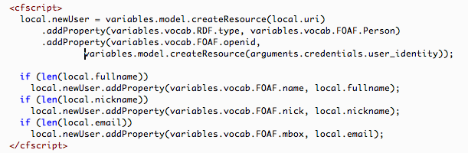
Updates via API

Slide 45
Case Study: Semantifying ePDX

Slide 46
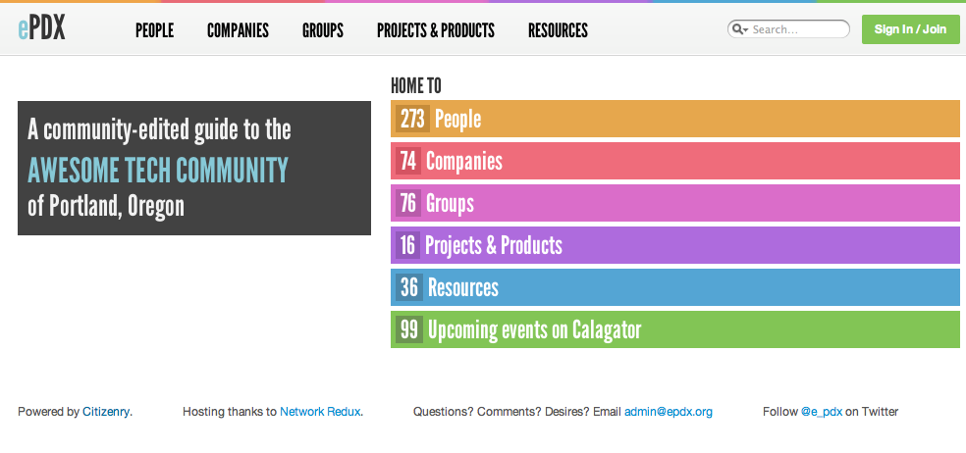
ePDX

Slide 47

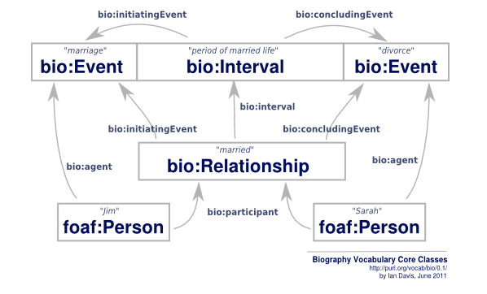
Description of a Project
Biography
Ontology

Slide 48
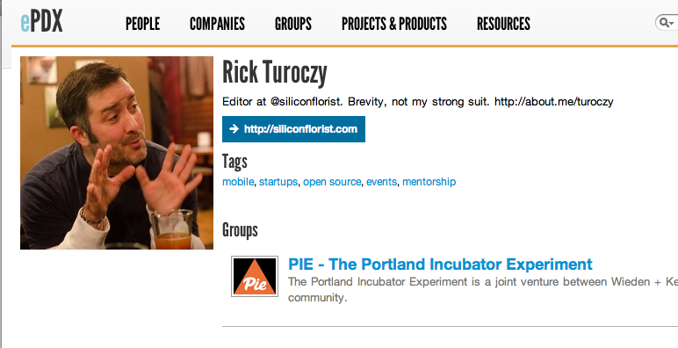

Slide 49
RDF Data Model - People
foaf:Person
foaf:family_name
foaf:givenname
foaf:mbox
bio:biography
foaf:homepage
foaf:depiction
foaf:account
foaf:accountName
foaf:accountProfilePage
foaf:accountServiceHomepage
Literal (“datataype”)properties
Resource (“object”)
properties

Slide 50
RDF Data Model – Organizations and Groups
foaf:Group
foaf:name
dct:description
foaf:member
foaf:homepage
Literal (“datataype”)properties
Resource (“object”)
properties

Slide 51
RDF Data Model – Organizations and Groups
Custom predicates
epdx:tag
epdx:technology
Resource (“object”)
properties

Slide 52
Custom properties and classes
epdx:tag
foaf:
Group
?
epdx:technology
foaf:
Group
?

Slide 53
RDF Data Model – Projects
doap:Project
doap:name
doap:homepage
doap:developer
doap:programming-language
Literal (“datataype”)properties
Resource (“object”)
properties

Slide 54
RDF Data Model
file:///Users/bpanulla/Desktop/presentations/osb11/epdx.svg

Slide 55
APIs
Java
Apache Jena
OWL API
Sesame
Pellet
Scala
scardf
Redland (C, Obj-C)
RDF.rb (ruby)
Rdflib (Python)
RDFa JavaScript API – under developmenthttps://github.com/webr3/rdf.js

Slide 56
Triple Stores
Apache Jena
Franz AllegroGraph (server)
Virtuoso Universal Server (server)
Mulgara (RESTful service)
New
Stardog - Integrated reasoning database

Slide 57
Learn More
Portland Semantic Web Interest Group
http://meetup.com/pdxsemweb
Unconference Day
“schema.org WTF”
“Microformats 2”
More?

Slide 58
Resources
Semantic Web Programming - John Hebeler, Matthew Fisher, Ryan Blace, and Andrew Perez-Lopez
Semantic Web for the Working Ontologist: Effective Modeling in RDFS and OWL -Dean Allemang and James Hendler
Programming the Semantic Web by Toby Segaran, Colin Evans, and Jamie Taylor

Slide 60
Backup

Slide 61
Three things the Semantic Web is not (mostly)

Slide 62

What is a Resource?
Everything on the web (or not) is a resource.
Uniform
Resource
Locator

Slide 63
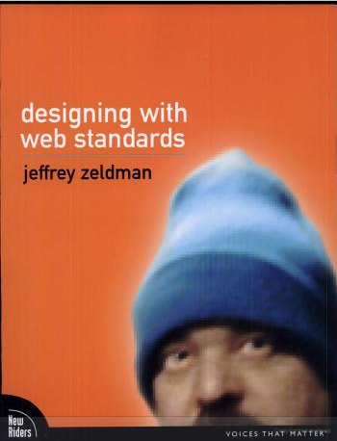
1. Semantic HTML

Slide 64

2. Warmed-over AI
http://www.movieprop.com/tvandmovie/terminator/t3endoskeletons1.jpg

Slide 65
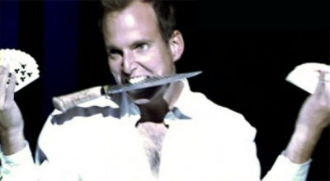
3. Magic
http://bostonist.com/attachments/Anna%20Edwards/109-gob-magic2.jpg

Slide 66
Who cares?

Slide 67
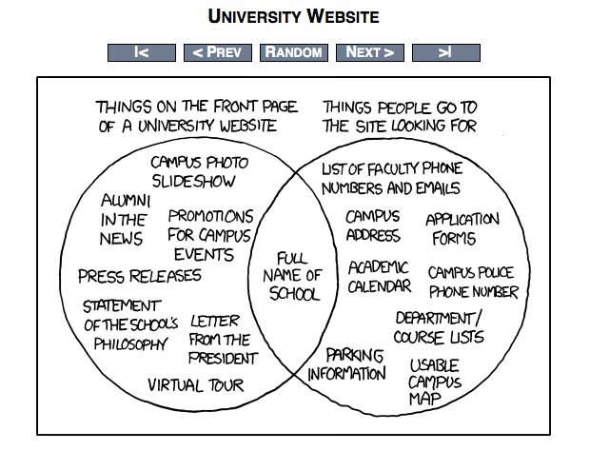
Semantic
Web
http://xkcd.com/773/

Slide 68
On NoSQL...

Slide 69
On Linked Data...

Slide 70
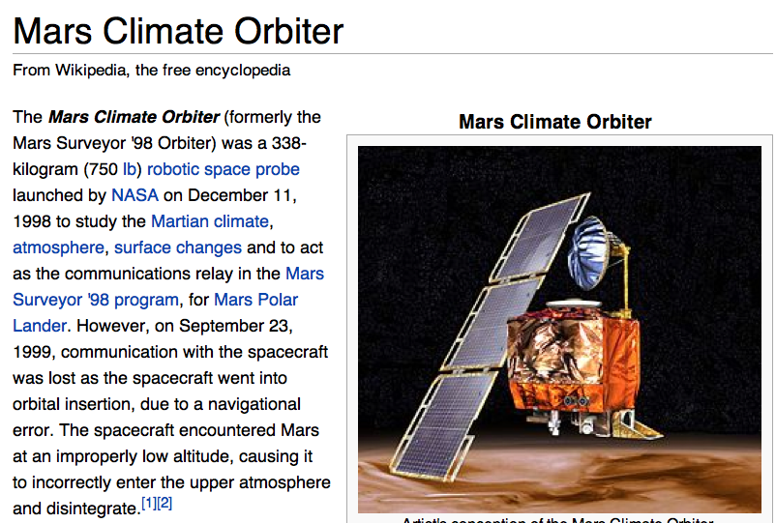

Slide 71
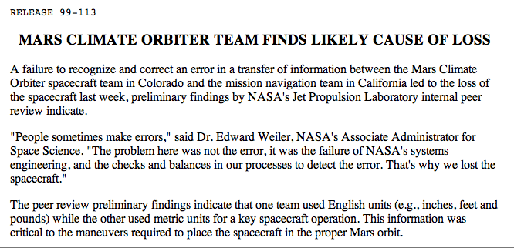
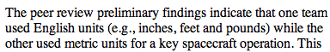
When things go wrong

Slide 72
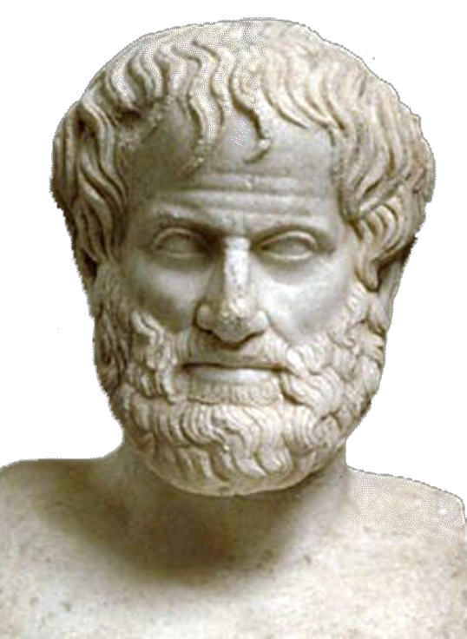
Ontologies
Ontology is the study of being or reality.
A Formal Ontology is a specification of a conceptualization (Gruber, 1995)
Aristotle ➔

Slide 73
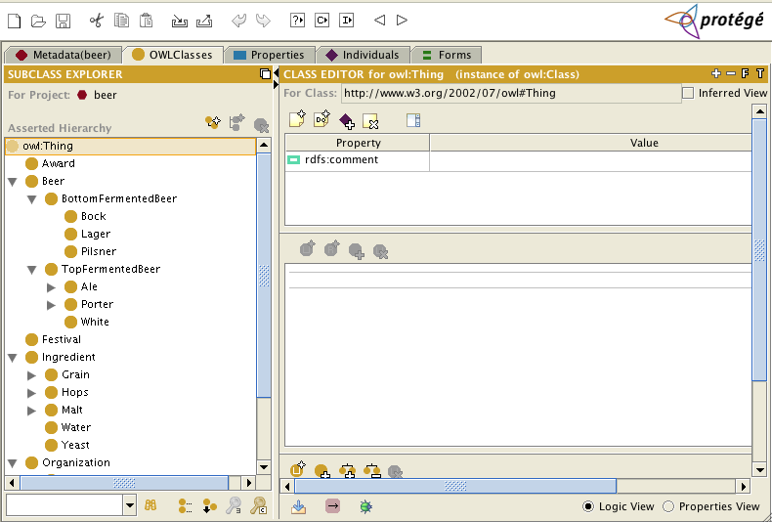
Protégé http://protege.stanford.edu/

Slide 74
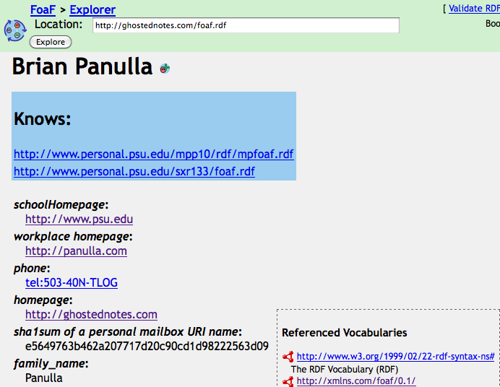
FOAF

Slide 75
The Good:
Domains where schemas/models change rapidly or data is sparse
Semantics of relational model inadequate (e.g. inferencing, inheritance)
Domains emphasizing relationships
Social networks
Taxonomies

Slide 76
The Bad:
Bad for opaque objects with few relationshps
Large sets of homogenous objects
RDBMS
NoSQL
Document DBs
Key/Value Stores
Graph databases
Weaknesses
Alternatives

Slide 77
Linked Data
Publish/Syndicate complete information sets
Embedded explicit semantics, unique identifiers
Have minimal impact to other Web information publishing
May be static or dynamically generated

Slide 78
SPARQL Query Types
SELECT – Returns tuples matching specified pattern
ASK – yes or no (tests for existence)
CONSTRUCT – Returns a graph
DESCRIBE – Returns a graph determined by the query engine

Slide 79
SPARQL Examples: ASK
ASK {
?uri foaf:openid <http://brian.panul.la>.
}

Slide 80
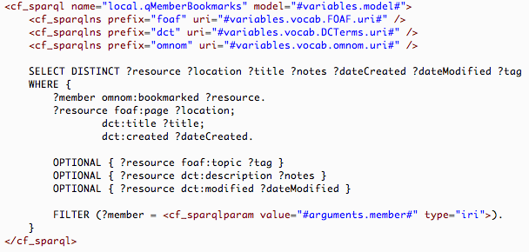
SPARQL Example: Bookmarks

